Slide 1
CROWD-TRACK: REAL-TIME MONITORING AND HEATMAP GENERATION SYSTEM FOR CONFERENCE HALLS

Slide 2
What is the AI Crowd Tracking Subsystem?
1
Detects and counts individuals.
Merges Model to NIVIDIA JETSON NANO.
4
2
Identifies entry and exit points.
Output: Live crowd insights via web interface.
5
3
Tracks movement & generates real-time heatmaps.

Slide 3

Physical Components
NIVIDIA jetson
Keyboard,Mouse,
Monitor
PC or Laptop
Fisheye camera

Slide 4
Object Detection Models
1
YOLOv5
4
Custom CNN Backbones
Fast, efficient to train, and worked well out of the box on my classroom data.
Tested lightweight models, but none beat YOLO on speed + performance.
2
YOLOv8
5
MMDetection (Rotated Anchors)
More accurate than YOLOv5 but needed more tuning.
Tried manual anchor tuning — results were inconsistent.
3
YOLOv8-OBB
6
MMRotate – R3Det
Handled rotated people better, but slower and not ideal for real-time.
Best accuracy on rotated views, but too slow and complex for real-time on Jetson.

Slide 5
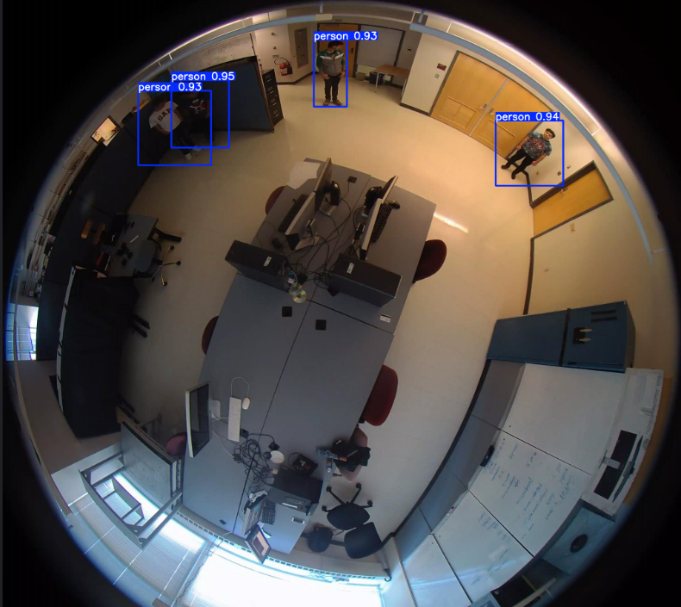
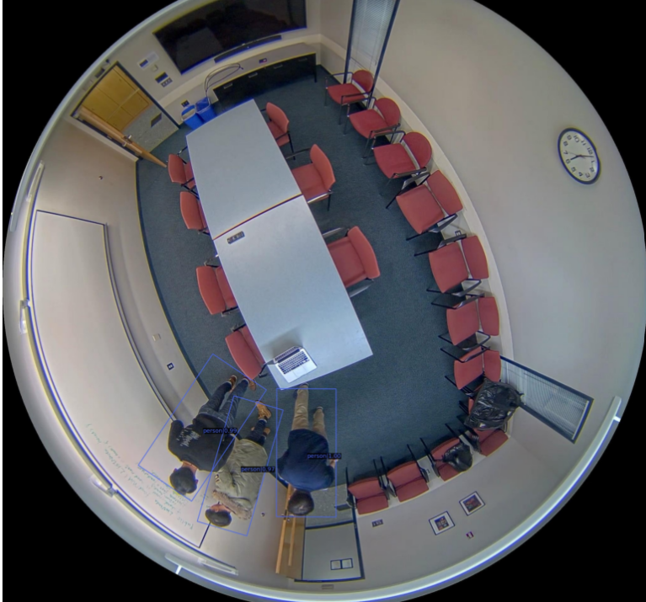
YOLOv5 VS MMRotate–R3Det
Specialized for Rotated Object Detection
1
1
High Accuracy after Label Fixing
Higher Detection Accuracy Compared to Some Alternatives
2
2
Best Balance of Speed, Accuracy, and Ease of Integration
Complexity and Usability Issues
3
3
Fast and Lightweight

Slide 6
Tracking Approaches
DeepSORT + supervision
ByteTrack + supervision
Cleaner tracking.
Distracting layout.
Struggled with ReID.
Cleaner layout.
Better ReID
Inaccurate tracking
DeepSORT (default)
2
3
DeepSORT + ReID + supervision
Jittery inaccurate tracks.
Frequent ID changes.
Clean tracking.
Clean layout.
Improved ReID
1
4

Slide 7
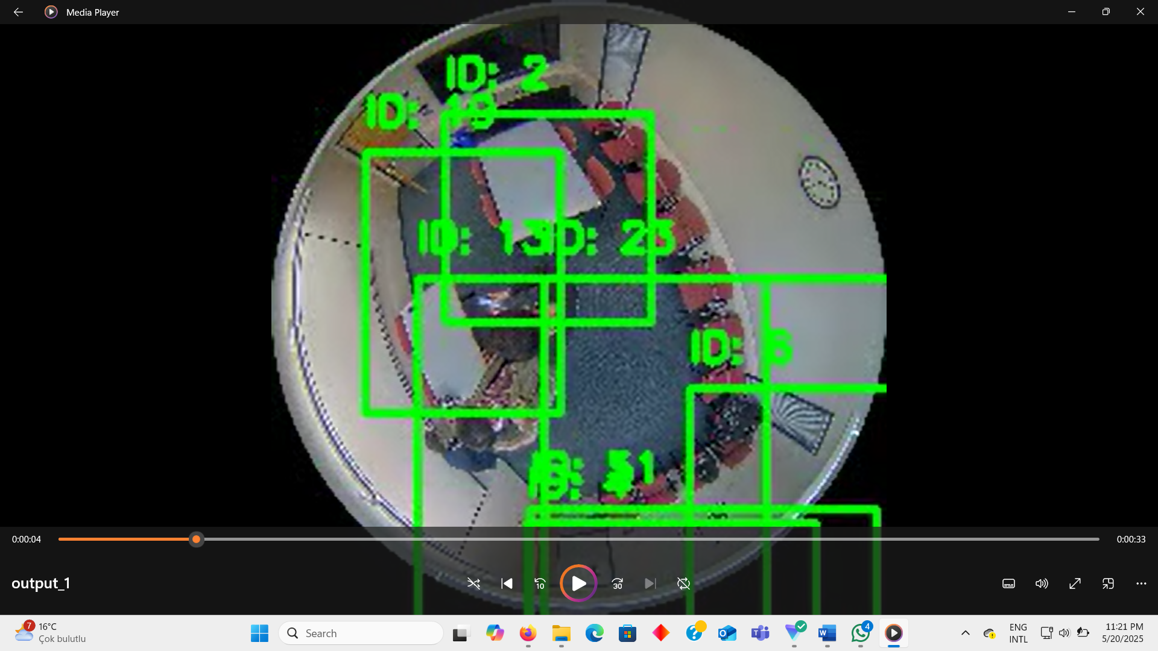
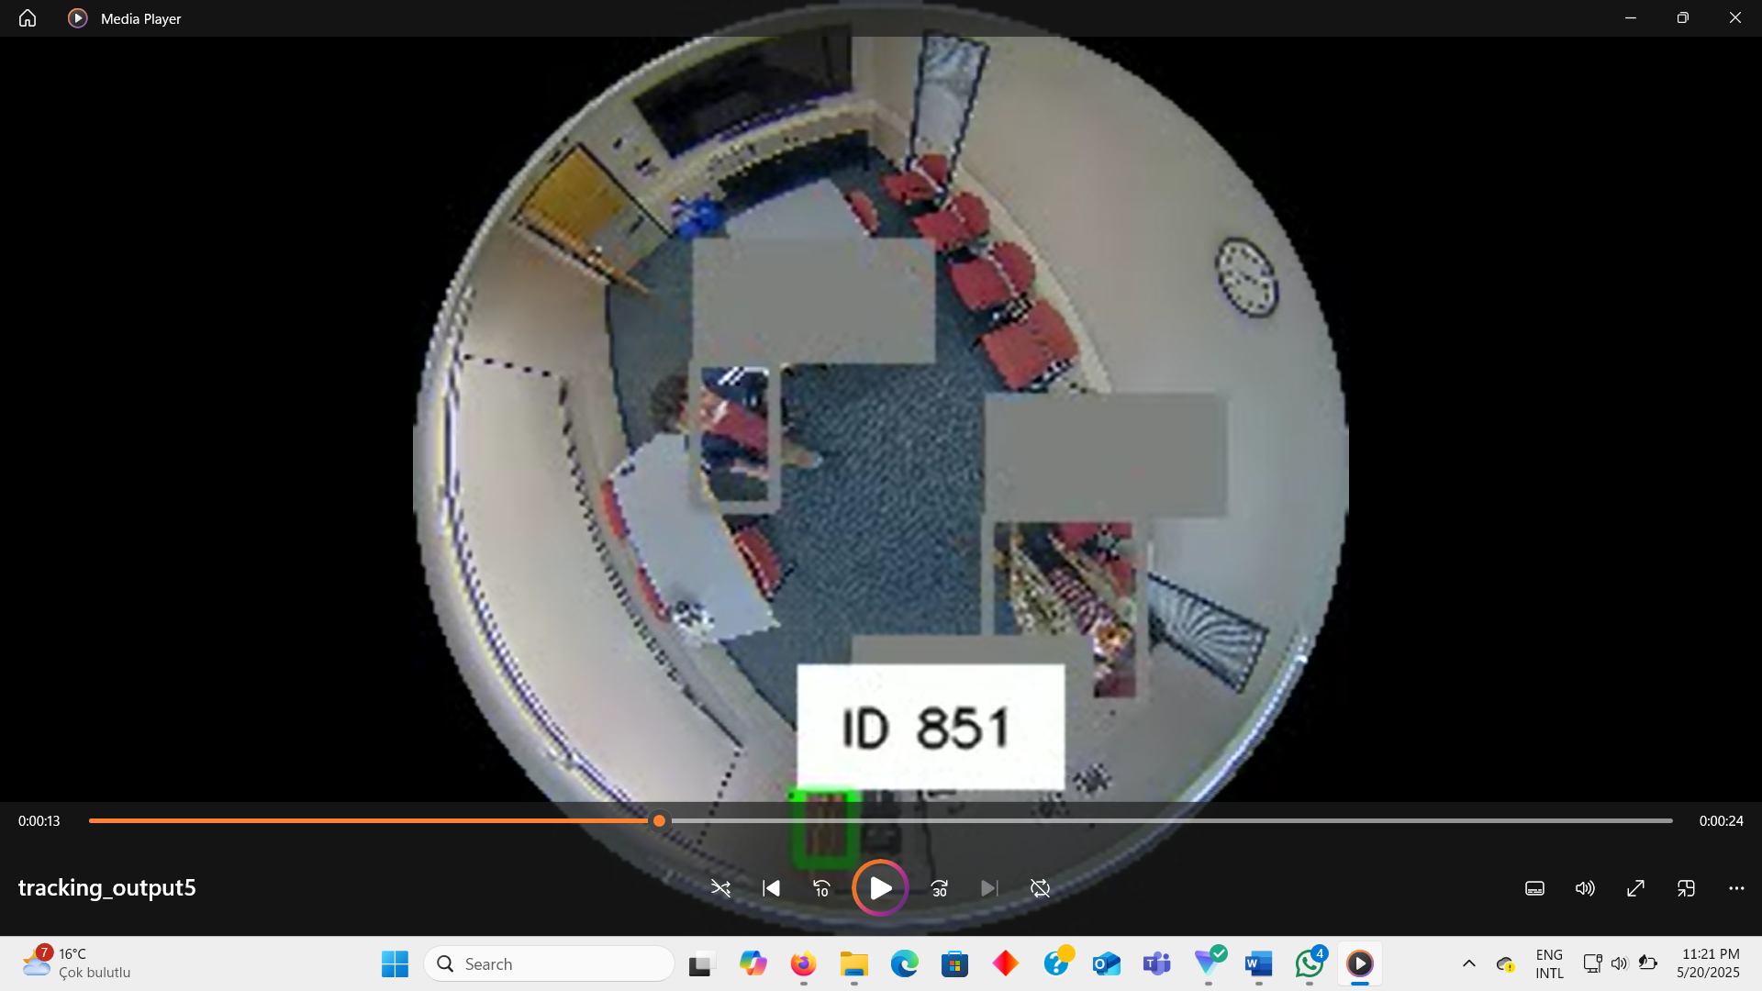

Slide 8
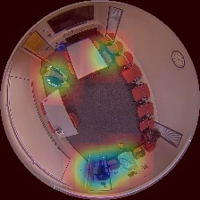
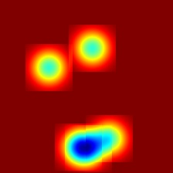
Heatmap Generation
Frame by Frame detections.
generating a 2D gaussian kernel on grid.
map is colored and normalized using OpenCV COLORMAP_JET.

Slide 9
Integration Workflow
Data Flow:
1
2
3
Jetson Nano
PC server
Jetson Nano (Display)
AI Server (PC)
Runs full Python/OpenCV/YOLOv5 inference
Applies DeepSORT tracking & heatmap generation
Serves processed frames & analytics back over network

Slide 10

Conclusion
Trained YOLOv5
Integrated with Nividia
Live Tracking
Created UI
Live Heatmap Generation

Slide 11
Thank You For listening!

